Slide 1
“You can’t cram the meaning of a whole %&!$# sentence into a single $&!#* vector!”
-- Ray Mooney, Association for Computational Linguistics (ACL) 2014
Notes:
Ray is somewhat right -- it's very difficult for a seq2seq model to capture everything relevant in a single context vector. So today we're going to talk about transformers which enable BERT… a model that crams the whole meaning of a sentence into a single embedding vector.

Slide 2
CIS 700-004: Lecture 10W
Attention and Transformers
03/20/19
Notes:
Done

Slide 3
Today's Agenda
HW2 overview and project clarifications
Attention (cont.)
PyTorch implementation
Does it have an inductive bias?
The transformer model
The overall architecture
Multi-head attention
PyTorch implementation
The cutting-edge of RNNs and transformers
ELMo
BERT
GPT-2

Slide 4
Attention

Slide 5
Wishlist of things to fix
Word embeddings are not context-sensitive.
RNNs' sequential processing is bad.
Language is not entirely processed linearly.
Long sequences become unlearnable (vanishing gradient, even with a forget gate).
Forward pass is not parallelizable.

Slide 6
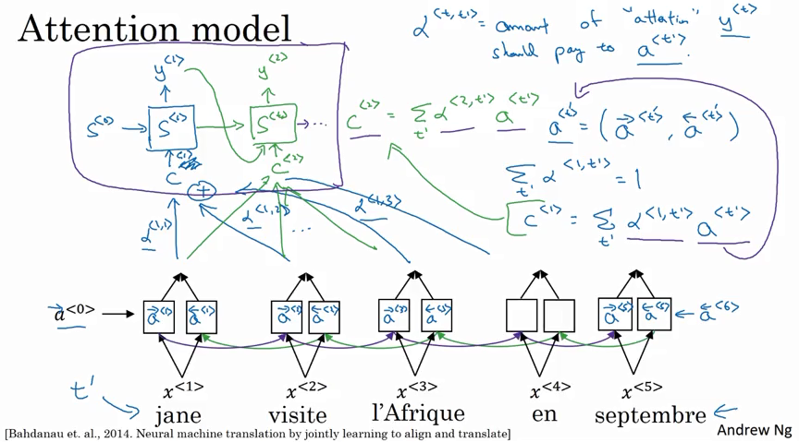
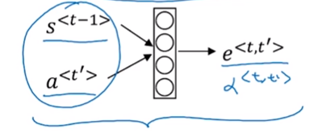
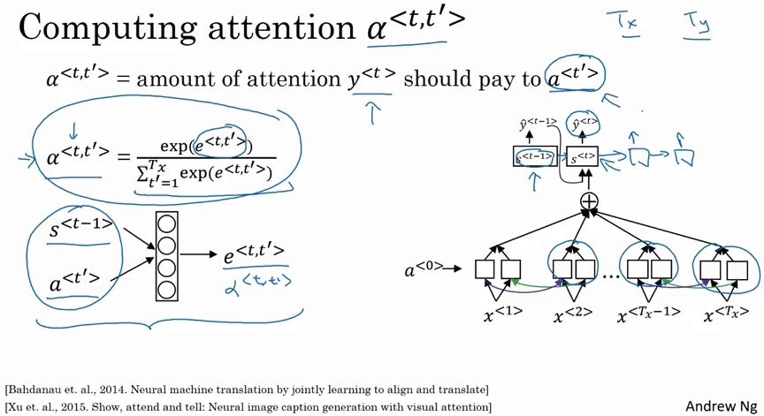

Slide 7
Let’s use attention on top of a seq2seq translation model that uses a biLSTM encoder and an LSTM decoder.

Slide 8
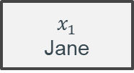
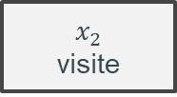
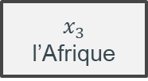
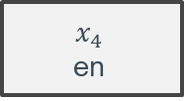
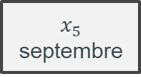
Let’s translate from French to English.

Slide 9
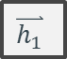
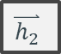
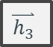
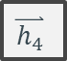
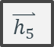
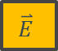

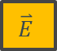

First, we compute the forward-facing hidden states of the biLSTM.

Slide 10
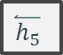
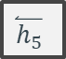
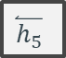


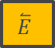


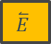

Next, we compute the backward-facing hidden states of the biLSTM.

Slide 11






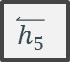
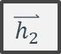

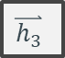
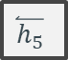
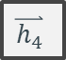



We then concatenate our hidden states.

Slide 12
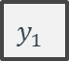
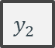

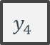
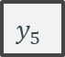
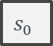

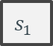

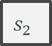
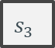

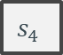
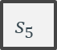





Now visualize the decoder.

Slide 13
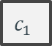
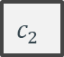

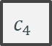



We want a context vector inputted to D at each timestep.

Slide 14
How do we encode the relevant information from n hidden states onto a fixed-length context vector?

Slide 15
How do we encode the relevant information from n hidden states onto a fixed-length context vector? For variable n.

Slide 16
How do we encode the relevant information from n hidden states onto a fixed-length context vector? For variable n. For a specific timestep i.

Slide 17

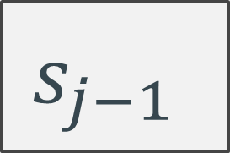

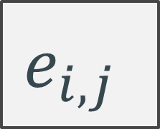
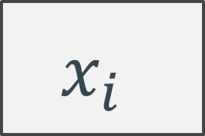


Slide 18

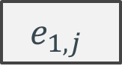
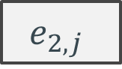
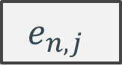



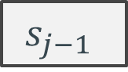
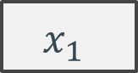
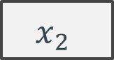
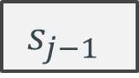
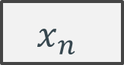

Slide 19
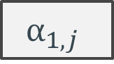


…and softmax.
Softmax

Slide 20
We’ll call this the attention module.
Attention

Slide 21








The attention module gives us a weight for each input.
Attention for output timestep 1
Notes:
Fix timestep 1

Slide 22

The context vector is a weighted sum of the hidden encodings.
Attention for output timestep 1
Notes:
Fix timestep 1

Slide 23
The context vector is a weighted sum of the hidden encodings.
Attention for output timestep 1
Notes:
Fix timestep 1

Slide 24





We then repeat for future timesteps.
Attention for output timestep 1
Notes:
Fix timestep 1

Slide 25

We then repeat for future timesteps.
Attention for output timestep 1
Notes:
Fix timestep 1

Slide 26
Done!

Slide 27


This kind of architecture performs well (SOTA circa 2016).
Notes:
https://arxiv.org/pdf/1508.04025.pdf

Slide 28
Does attention have an inductive bias?

Slide 29
Interpreting attention as an inductive bias
L1 regularization confers a sparsity prior at the level of params.
(Hard) attention confers a sparsity prior at the level of computation/information flow.
Soft attention : hard attention :: L2 regularization : L1 regularization.
Notes:
Sparsity prior.

Slide 30
What’s wrong with attentioned seq2seq models?
The (optional) encoder is still an RNN.
And you won’t get very far without one.
The (non-negotiable) decoder is still an RNN.
Notes:
We wanted to parallelize to reduce computation! But attention only increases computation as of right now.

Slide 31
Transformers

Slide 32

Notes:
A transformer is a static electrical device that transfers electrical energy between two or more circuits.

Slide 33


Slide 34


Slide 35


Slide 36

What is a transformer?
A Google Brain model.
Variable-length input
Fixed-length output (but typically extended to a variable-length output)
No recurrence
Surprisingly not patented.
Uses 3 kinds of attention
Encoder self-attention.
Decoder self-attention.
Encoder-decoder multi-head attention.
Notes:
https://arxiv.org/pdf/1706.03762.pdf

Slide 37
The overall architecture

Slide 38

Let’s blow up a transformer bit-by-bit.

Slide 39

There is an encoder and a decoder.

Slide 40

There are several encoder and decoder layers.
Notes:
Constant number, tuned manually

Slide 41

Each encoder / decoder layer has a self-attention layer and a ff.

Slide 42

Transformers use the self-attention in the encoder and decoder to learn better context-sensitive representations of the inputs.

Slide 43
Transformers use the self-attention in the encoder and decoder to learn better context-sensitive representations of the inputs.

Slide 44
Understanding multihead attention

Slide 45


Slide 46
The inputs: K, V, Q.
In seq2seq attention, we used the n encoder hidden states to learn attention weights over themselves (the encoder hidden states) in order to update the decoder hidden state.
Rename these as key, value, query.
Key vectors determine the attention weights.
Value vectors get multiplied by attention weights.
Query vectors are what we're trying to learn context for.

Slide 47

Scaled dot-product attention
Key vectors determine the attention weights.
Value vectors get multiplied by attention weights.
Query vectors are what we're trying to learn context for.

Slide 48
Scaled dot-product attention
We weight each value vector v based on how similar its corresponding key is to the query.
Key vectors determine the attention weights.
Value vectors get multiplied by attention weights.
Query vectors are what we're trying to learn context for.

Slide 49
The entire multihead attention module
Notes:
Just a good way of attendint to information from different representation subspaces.

Slide 50
The entire multihead attention module
Take h different linear transformations of each input (h = 8 in the original paper).
Notes:
Just a good way of attendint to information from different representation subspaces.

Slide 51
The entire multihead attention module
Run each of the h ordered triples of transformed inputs through the scaled dot-product module.
Take h different linear transformations of each input (h = 8 in the original paper).
Notes:
Just a good way of attendint to information from different representation subspaces.

Slide 52
The entire multihead attention module
One more linear transform for good measure.
Run each of the h ordered triples of transformed inputs through the scaled dot-product module.
Take h different linear transformations of each input (h = 8 in the original paper).
Notes:
Just a good way of attendint to information from different representation subspaces.

Slide 53

What are K, V, Q in the encoder?

Slide 54
What are K, V, Q in the encoder?

Slide 55
What are K, V, Q in the encoder?
Encoder Layer 1
Encoder Layer 2
Query is also the positionally encoded input.
Key, value are both the positionally encoded input.

Slide 56
What are K, V, Q in the encoder?
Encoder Layer 1
Encoder Layer 2
Query is also the positionally encoded input.
Query is the value. (self-attention)
Key, value are both the positionally encoded input.
Layer 1 outputs a new key, value pair

Slide 57
The encoder sends its final (K, V) output to each of the decoder layers.

Slide 58

What are K, V, Q in the decoder?
Encoder-decoder multi-head attention
Key, value are the final encoding layer's outputs.
Query is the output of the previous decoder layer.
Decoder self-attention
Key, value are the the outputs of the previous layer.
Query is the value (self-attention).
Notes:
Caveat: we mask the attention weights so that the decoder outputs for position i can only see the query at positions less than i.

Slide 59
One last look at the whole architecture.

Slide 60
One last look at the whole architecture.

Slide 61

We get the variable-length outputs using beam search.

Slide 62
So why use transformers?

Slide 63

Nice computational properties
Amount of computation per layer is reduced.
Number of layers (i.e. path length along computational graph) is reduced.
Almost all computation is parallelizable.
Notes:
Trainable in "only 12 hours" for SOTA

Slide 64

State-of-the-art performance

Slide 65

No, seriously. State-of-the-art performance.
Notes:
https://github.com/RedditSota/state-of-the-art-result-for-machine-learning-problems

Slide 66
Transformers in PyTorch

Slide 67


Attentioned RNN: the encoder
Notes:
https://github.com/jadore801120/attention-is-all-you-need-pytorch/blob/master/transformer/Models.py

Slide 68


Attentioned RNN: the decoder
Notes:
https://github.com/jadore801120/attention-is-all-you-need-pytorch/blob/master/transformer/Models.py

Slide 69
Notable pre-trained NLP models

Slide 70


Slide 71
ELMo: Embeddings from Language Models
Pre-trained biLSTM for contextual embedding

Slide 72

Context-based disambiguation is hard.
Notes:
https://allennlp.org/elmo

Slide 73

ELMo's biLSTM is pretrained on a language model.
Notes:
https://allennlp.org/elmo http://jalammar.github.io/illustrated-bert/

Slide 74

ELMo's embedding of a word given the sentence is the concatenation of its biLSTM's hidden states for the word.
Notes:
https://allennlp.org/elmo

Slide 75

ELMo: biLSTM for neural word embeddings
Notes:
https://allennlp.org/elmo

Slide 76
BERT: Bidirectional Encoder Representations from Transformers
Pre-trained transformer encoder for sentence embedding

Slide 77

BERT is ImageNet for language
Notes:
https://arxiv.org/abs/1810.04805

Slide 78

BERT is ImageNet for language
Notes:
https://arxiv.org/abs/1810.04805

Slide 79

BERT's architecture is just a transformer's encoder stack.
Notes:
https://arxiv.org/abs/1810.04805

Slide 80

BERT is trained just like a skip-gram model.
Notes:
https://arxiv.org/abs/1810.04805

Slide 81
“You can’t cram the meaning of a whole %&!$# sentence into a single $&!#* vector!”
-- Ray Mooney, Association for Computational Linguistics (ACL) 2014
Notes:
Ray is somewhat right -- it's very difficult for a seq2seq model to capture everything relevant in a single context vector. So today we're going to talk about transformers which enable BERT… a model that crams the whole meaning of a sentence into a single embedding vector.

Slide 82
OpenAI's transformer
Pre-trained transformer decoder for language modeling

Slide 83

The original OpenAI transformer is just a decoder stack trained on language modeling (unsupervised).

Slide 84

As with BERT, you can use the pretrained model for any task.

Slide 85

Different tasks use the OpenAI transformer in different ways.

Slide 86
OpenAI tested their transformer on zero-shot learning.
"For SST-2 (sentiment analysis), we append the token very to each example and restrict the language model’s output distribution to only the words positive and negative and guess the token it assigns higher probability to as the prediction…"

Slide 87

Open AI's GPT-2 is just a really, really large transformer.
1.5 billion parameters!
Trained on 8 million web pages!
Scraped every outgoing link on Reddit with at least 3 upvotes.
Notes:
https://openai.com/blog/better-language-models/

Slide 88
Looking forward
New module next week: special topics
Reinforcement learning
Optimization
Neuroscience
Causality
Guest lectures
Project proposal is due on Friday
Start HW2 and the project early!

